Slide 1
Image Thresholding
Image thresholding is a simple way of partitioning an image into a foreground and background.
This image analysis technique is a type of image segmentation that isolates objects by converting grayscale images into binary images.
In computer vision image segmentation is the base for analysing images by converting an image into multiple segments (super pixel) or regions.
Image thresholding is one of the simplest method to separate regions which are higher than the set threshold.

Slide 2
Image Thresholding
Thresholding is a type of image segmentation, where we change the pixels of an image to make the image easier to analyze.
In thresholding, we convert an image from color or grayscale into a binary image, i.e., one that is simply black and white.
Most frequently, we use thresholding as a way to select areas of interest of an image, while ignoring the parts we are not concerned with.

Slide 3

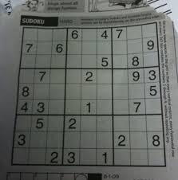
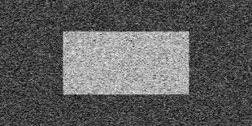
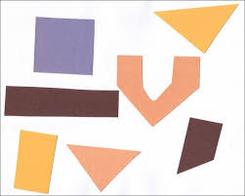
Image Thresholding
gradient.png
2. dave.jpg
noisy2.png
4. threshold_image.jpeg

Slide 4
Simple Thresholding
If pixel value is greater than a threshold value, it is assigned one value (may be white), else it is assigned another value (may be black).
The function used is cv2.threshold. First argument is the source image, which should be a grayscale image.
Second argument is the threshold value which is used to classify the pixel values.
Third argument is the maxVal which represents the value to be given if pixel value is more than (sometimes less than) the threshold value.

Slide 5
Simple Thresholding
OpenCV provides different styles of thresholding and it is decided by the fourth parameter of the function.
Different types are:
cv2.THRESH_BINARY
cv2.THRESH_BINARY_INV
cv2.THRESH_TRUNC
cv2.THRESH_TOZERO
cv2.THRESH_TOZERO_INV

Slide 6
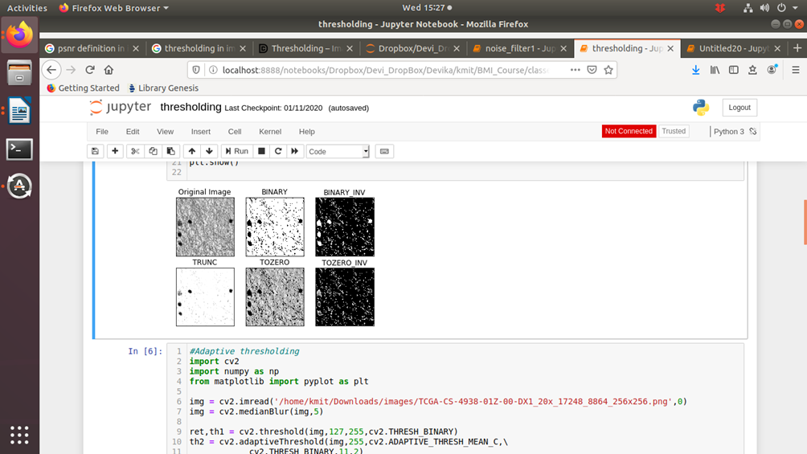
Simple Thresholding
cv2.THRESH_TRUNC
if src(x,y) > thresh
dst(x,y) = thresh else dst(x,y) = src(x,y)

Slide 7
Adaptive Thresholding
In the previous section, we used one global value as a threshold.
But this might not be good in all cases, e.g. if an image has different lighting conditions in different areas.
In that case, adaptive thresholding can help.
Here, the algorithm determines the threshold for a pixel based on a small region around it.
So we get different thresholds for different regions of the same image which gives better results for images with varying illumination.
:

Slide 8
Adaptive Thresholding
In addition to the parameters described above, the method cv.adaptiveThreshold takes three input parameters:
The adaptiveMethod decides how the threshold value is calculated:
cv.ADAPTIVE_THRESH_MEAN_C: The threshold value is the mean of the neighbourhood area minus the constant C.
cv.ADAPTIVE_THRESH_GAUSSIAN_C: The threshold value is a gaussian-weighted sum of the neighbourhood values minus the constant C.
The blockSize determines the size of the neighbourhood area and C is a constant that is subtracted from the mean or weighted sum of the neighbourhood pixels.

Slide 9
Adaptive Thresholding
import cv2 as cv
import numpy as np
from matplotlib import pyplot as plt
img = cv.imread('sudoku.png',0)
img = cv.medianBlur(img,5)
ret,th1 = cv.threshold(img,127,255,cv.THRESH_BINARY)
th2 = cv.adaptiveThreshold(img,255,cv.ADAPTIVE_THRESH_MEAN_C,\
cv.THRESH_BINARY,11,2)

Slide 10
Adaptive Thresholding
th3=cv.adaptiveThreshold(img,255,cv.ADAPTIVE_THRESH_GAUSSIAN_C,\
cv.THRESH_BINARY,11,2)
titles = ['Original Image', 'Global Thresholding (v = 127)',
'Adaptive Mean Thresholding', 'Adaptive Gaussian Thresholding']
images = [img, th1, th2, th3]
for i in xrange(4):
plt.subplot(2,2,i+1),plt.imshow(images[i],'gray')
plt.title(titles[i])
plt.xticks([]),plt.yticks([])
plt.show()

Slide 11
Adaptive Thresholding
images = [img, th1, th2, th3]
for i in xrange(4):
plt.subplot(2,2,i+1),plt.imshow(images[i],'gray')
plt.title(titles[i])
plt.xticks([]),plt.yticks([])
plt.show()

Slide 12
Otsu's Binarization
In global thresholding, we used an arbitrary chosen value as a threshold.
In contrast, Otsu's method avoids having to choose a value and determines it automatically.
Consider an image with only two distinct image values (bimodal image), where the histogram would only consist of two peaks. A good threshold would be in the middle of those two values.
Similarly, Otsu's method determines an optimal global threshold value from the image histogram.

Slide 13
Otsu's Binarization
In order to do so, the cv.threshold() function is used, where cv.THRESH_OTSU is passed as an extra flag.
The threshold value can be chosen arbitrary. The algorithm then finds the optimal threshold value which is returned as the first output.
Example below. The input image is a noisy image. In the first case, global thresholding with a value of 127 is applied.
In the second case, Otsu's thresholding is applied directly.
In the third case, the image is first filtered with a 5x5 gaussian kernel to remove the noise, then Otsu thresholding is applied.

Slide 14
Otsu's Binarization
In order to do so, the cv.threshold() function is used, where cv.THRESH_OTSU is passed as an extra flag.
The threshold value can be chosen arbitrary. The algorithm then finds the optimal threshold value which is returned as the first output.
Example below. The input image is a noisy image. In the first case, global thresholding with a value of 127 is applied.
In the second case, Otsu's thresholding is applied directly. In the third case, the image is first filtered with a 5x5 gaussian kernel to remove the noise, then Otsu thresholding is applied.

